Slide 1
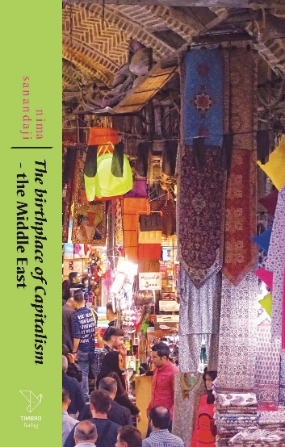

Slide 2
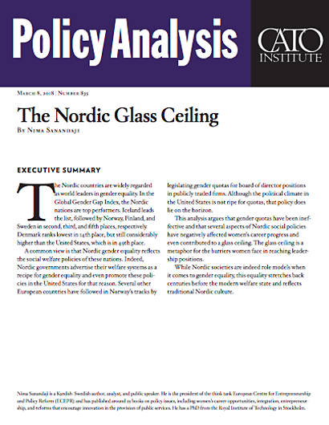
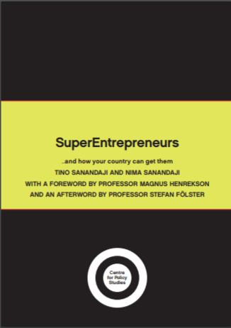

Slide 3
Where is freedom in Europe?
According to the World Value Survey, it is in Romania.

Slide 6
Why do a higher share of Romanians feel they have freedom of choice & control than in other parts of Europe?
Likely reason: development trajectory.

Slide 9
Romania lags behind rest of Europe economically, but is already giving rise to knowledge-intensive sector.

Slide 10
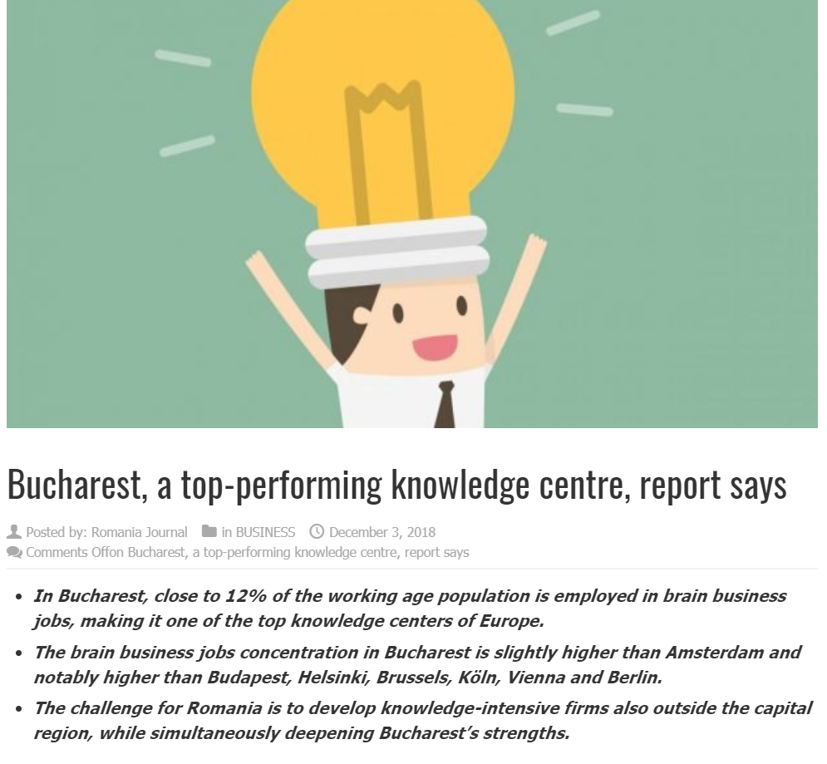

Slide 11
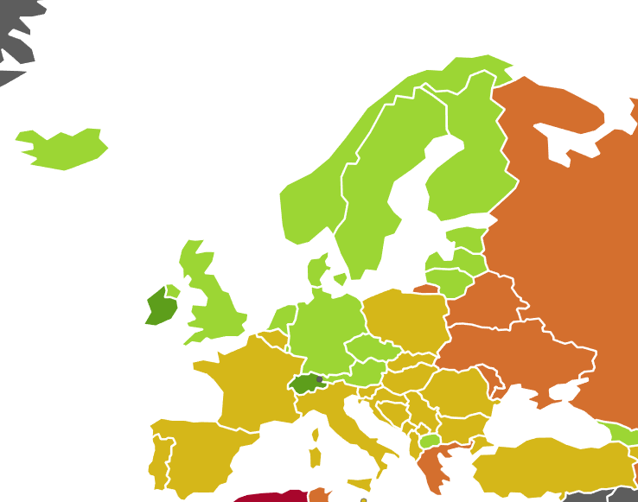
Two things still keep Romania back:
Share of higher education students lower than in other parts of Europe.
Too much state control, too little economic freedom.

Slide 13
Personal liberties overall strong
- Freedom of movement & assembly, sexual freedom.
- Safety from crime.
- But religious freedom and rule of law need to strenghten.

Slide 14
Conclusion:
The positive development that already exists in Romania can be improved.
The recipe for success:
Less state control, reduced corruption, free markets & investment in education.

