Slide 1
Globalization and Its Critics
Leszek Balcerowicz
Warsaw, 3rd April 2019

Slide 2
Content of the presentation:
I. Globalization and Its Components
II. Three Points of view on Globalization
III. Trade Globalization
IV. Financial Globalisation
V. Concluding Comments

Slide 3
I. Globalization and Its Components
In the most general sense the process of globalization consists in increasing contacts (including contracts) among individuals’ and organizations from various countries. In this sense it is the opposite of isolationism.
Globalization is usually divided into:
Trade globalization, i.e. trade in material products;
Financial globalization, i.e. flows of capital;
International migration.
Additions:
globalization of communication;
globalization of services.

Slide 4
I. Globalization and Its Components
Ist addition: Globalization of communication:
increased flows of data which distinguishes modern globalization, with the invention of the telegraph, and later ICT technology, from the whole history of mankind until the 19th century.
An interesting question is to what extent can this technology replace the face to face contacts between people from various places (Baldwin, 2016).
2nd addition: globalization of services
Goods the production of which cannot be separated from their consumption. Therefore, the globalization of services has to be contained (until recently) in other flows:
FDI;
International tourism;
Providers of certain services;
Modern improvements in ICT technologies

Slide 5
II. Three Points of view on Globalization
1st point of view: the economic analysis:
aims in general to explain the socio-economic outcomes, e.g. growth, stability, poverty, (un)employment, inequalities;
trade isolationism, present in the socialist (non-market) economies and in the distorted, quasi-statist market economies, has been very costly in terms of foregone economic growth and thus lower standard of living of millions of people. (A.M. Taylor 1996, M. Wolff, 2004);
many professional economists had advocated socialism, i.e. the replacement of private ownership by the monopoly of the state ownership, and the replacement of the market by central planning (Balcerowicz, 1995);
the statist doctrine of import substitution was until recently a part of mainstream economics, and it was supported by the World Bank (Wolf, 2004);
The present discussion on the economics of trade globalization also often suffers from the lack of clarity, wrong assessments and sometimes wrong recommendations

Slide 6
II. Three Points of view on Globalization
2nd point of view: the political economy analysis
aims at explaining political outcomes by linking them to various, less or more probable causes, including socio-economic outcomes.
One should be very careful in drawing general conclusions from specific cases, e.g. from the present political backlash against trade globalization in the US under then candidate and now President Trump.
political outcomes are probably more difficult to explain than economic ones because of a larger role of chance factors.
3rd point of view: the moral analysis:
should not be confused with moralizing.
deals with the moral standards of judging various outcomes, including those that are - rightly or wrongly, linked to globalization.
All too often economists, and even more, - other social scientists focus on the people whom they regard as globalization’s “losers” in the developed economies and disregard the beneficiaries of globalization in the poor countries (not to mention the winners in the developed states). Such a focus is a display of nationalistic ethics.

Slide 7
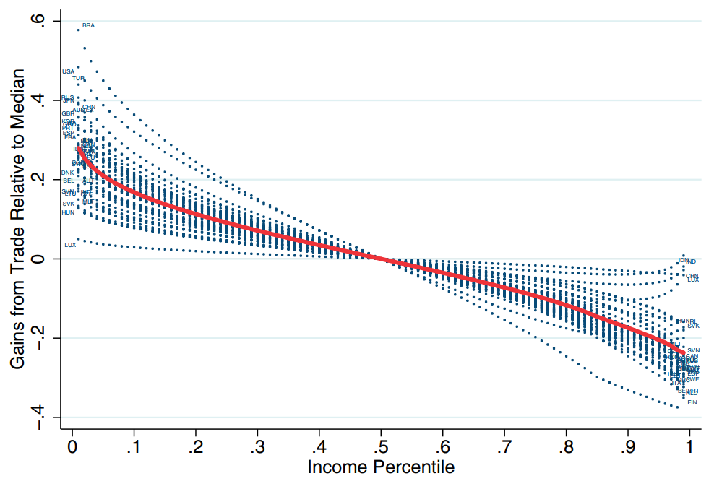
II. Three Points of view on Globalization
Diagram 1: The poor gain the most from trade as their consumption patterns are focused on tradable goods, e.g. food and manufactured goods, and to lesser extent services.
Distribution of unequal gains from trade (deviations are relative to the median individual; solid line is the average)
In moving from autarky to trade, the relative prices of goods consumed intensively by the poor, such as food, fall more.
The gains from opening to trade are estimated at 63% for the 10th percentile of the income distribution and 28% for the 90th percentile.
The poor gain the most in every of the 40 countries modeled.
The sample consists of 27 EU Member States, Turkey, the USA, Canada, Australia, Japan, Mexico, Brazil, Japan, Korea, Taiwan, China, India and Indonesia.
Source: Fajgelbaum, P.D. i Khandelwal, A.K. (2016), Measuring the Unequal Gains from Trade, The Quarterly Journal of Economics 131 (3): 1113-1180

Slide 8
II. Three Points of view on Globalization
Diagram II: In 1981 42% of world population lived at $1.90 (2011 USD, PPP) and only 11% in 2013. This is despite the fact that world population increased during this time by 59%.
Source: World Bank data

Slide 9
II. Three Points of view on Globalization
Finally, there is a utopian ethics which demands that people be guided by altruism in their mutual interactions and condemns markets, including the global ones, because they rely on the self-interest of the buyers and sellers. Needless to say, it is a display of irrationality, of deep ignorance about evolutionary psychology, and history, and it is an offense against common sense.
Proponents of nationalistic and utopian ethics share the same slogans. For example, they criticize the free trade in the name of “fair trade” - even though they give various meanings to this expression.
Nationalistic ethics is much stronger in politics than the universal one. But this is not an argument in favor of the academics, who strengthen this bias by bashing globalization in the name of defending globalization’s “losers” in the rich countries, and who disregard its beneficiaries in the poor ones. At the minimum they should not pretend to represent a moral high ground, and they should not be regarded as such by other people.

Slide 10
III. Crude Anti - Globalism
Appears in two forms:
The anti-capitalist propaganda, based on utopian ethics and on a complete disregard of economic history and of analytical economics. It usually appears under the label of the “left”.
The nationalistic propaganda which is based on nationalistic ethics and targets foreigners as migrants or producers of imported goods. It is usually belonging for the “right”.
The main representatives of the crude anti-globalism stem from outside mainstream economics, even though some professional economists lend credibility to this phenomenon by focusing on those who are considered the losers in the developed world and on the inequalities ascribed to trade globalization.

Slide 11
III. Crude Anti - Globalism
Martin Wolf (2004) has brilliantly exposed the logical and empirical fallacies of crude anti-globalism. The main ones include:
Propositions to replace the globalized world with one consisting of many self-sufficient units;
Advocating replacing capitalism with “something nicer”;
Claiming that globalization destroys national states and democracy;
Demonizing multinational corporations;
Claiming that globalization is responsible for mass destitution by fostering increased inequality within and between nations.;
Blaming globalization for the destruction of the environment, etc..
The crude anti-globalism, with its false simplicity and emotionally loaded accusations, is a dangerous phenomenon which, for those very reasons, enjoys mass popularity. In that, it resembles the previous quasi-religious or nationalistic movements: communism and fascism. Therefore, the proponents of reason and of a liberal order should unmask the fallacies of crude anti-globalization in the mass media. The propaganda which does not meet a strong response tends to win.

Slide 12
IV. Trade Globalization
In discussing trade globalization One should consider two types of institutions and policies (for short: policies):
those which determine the scope of a country’s openness to trade (Policy 1)
those which influence the individuals’’ possibilities and incentives to adjust to new opportunities and threats, including changes that are linked to trade opening (Policy 2).
Socio-economic outcomes result from various factors. One of the analytical challenges is to isolate the impact of trade opening from that of other factors, especially of technological change (Autor et al, 2015) which, in turn, depends on countries’ institutional systems: there is not a good substitute for extensive and equal economic freedom within the framework of the rule of law.

Slide 13
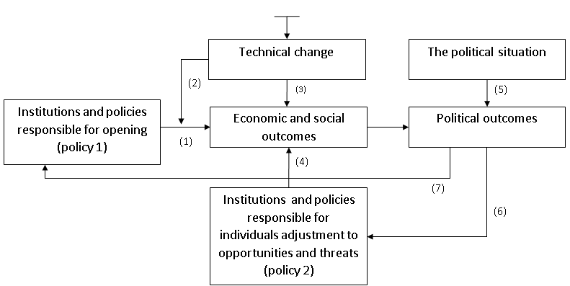
IV. Trade Globalization
Diagram 3: Policies, globalization, outcomes:

Slide 14
IV. Trade Globalization
In speaking about trade globalization one must consider the demise of socialism, first in China, and later in the former Soviet bloc. This has opened the way to the market reforms in these countries, including the liberalization of trade (Diagram 2.). There can be little doubt that these liberal reforms were hugely beneficial to the societies in the former socialist countries. For the counterexamples look to North Korea, Cuba and Venezuela.

Slide 15
IV. Trade Globalization
Diagram 4: Exports of post-communist economies pre- and post-transition, and selected other exporters.
Merchandise exports (%GDP)
Note 1: All EU-11 CEE stands for all 11 EU Post-Communist economies. These have high GDP export shares as these are mostly small open economies and exports are high within the EU.
Note 2: Declines in world export shares of the UK, France and Germany are in line with a general decline in export shares of high-income economies from 84% in 1992 to 67% in 2016.
Note 3: Russian exports increased, but they are mostly raw materials. UN COMTRADE database shows that the share of minerals, metals, vegetables, foodstuffs and wood in Russian exports stood at 81% in 2016 (63% in 1995). According to the Harvard Atlas of Economic Complexity, the diversity and ubiquity of Russian exports between 1995 and 2016 has fallen.
Source: UNCTAD and FRED (only for current to 2009 USD conversion); *For Czechia and Slovakia the year is 1993 instead od 1992 due to the dissolution of Czechoslovakia

Slide 16
IV. Trade Globalization
The increase of exports (and imports) of the post-socialist economies depended not only on their radical institutional change but also on the appearance and spread of ICT-based technology, invented in the developed countries. This technology has allowed a rapid development of global value chains (R. Baldwin, 2016). This is an example of the interaction between radical institutional change in former socialist economies and modern technology stemming from the West in driving trade globalization. The largest beneficiaries on the exporting side have been, of course, China, and in Europe, Poland. Russia has increased its dependence on the production and exports of oil and gas.
The socio-economic outcomes in poor globalizing countries depended not only on the scope of their trade opening (Policy 1), but also on their Policy 2, which determines the extent to which resources move in response to trade liberalization. Here it is interesting to compare China and India (Diagram 3). As one can see, the structural shift from agriculture to manufacturing (proxied by the increase of urbanization) has been much larger in China than in India. The difference is largely due to the fact that India has had much stronger barriers to spatial and occupational mobility: poor infrastructure, poor education, heavy subsidization of agriculture, very restrictive labor laws which discourage private firms from hiring new people. (see: Kazmin, 2014, Shanmugaratnam, 2016). This is an example how bad Policy 2 limits the gains from trade globalization for the poor.

Slide 17
IV. Trade Globalization
Diagram 5: China and India urbanization (much larger in China, contributing to better economic performance).
Urban population (%) Openness (Trade as % of GDP)
GDP per capita PPP in 2016 US$ Tariff rate, applied, weighted mean, all products (%)
Source: Urban population, Openness and Tariff data comes from the World Bank; GDP statistics come from the Total Economic Database (May 2017) prepared by the Conference Board

Slide 18
IV. Trade Globalization
Let me now use Diagram 3. to discuss the socio-economic outcomes and political reactions to trade globalization in the developed countries. In this case, Policies 1 refer to the trade liberalization and other market reforms in the poorer economies, and the trade agreements concluded between them and the rich economies, e.g. NAFTA. Policies 2 and outcomes in Diagram 1 refer to the developed countries.
What strikes me is that the popular and academic discussions about the outcomes linked, rightly or wrongly, to trade globalization are recently dominated by the negative issues (messages), especially regarding the increase in income inequalities and the related topic of the globalization’s “losers”. This seems be more true of the US than of Europe, where the negative news focuses more on immigration.
There are two main issues related to trade globalization in the developed economies: a) the role of import competition and technological change in producing outcomes criticized as negative by some observers and politicians and, more importantly, b) the role of policies which determine the individuals’’ adjustment. (Policy 2)

Slide 19
IV. Trade Globalization
However, it is not most important that the popular focus on the “losers” and on inequalities often wrongly attributes these phenomena to import competition disregarding the role of modern technology. What matters more is that the only type of lastingly growing economy is a market economy with a lot of competition including that, based on innovations. And market competition always produces some winners and some losers, at least in relative sense (see: the Schumpeterian “creative destruction”). Backlash against trade globalization is, therefore, just a manifestation of an old phenomenon - a protest against competition. In the Middle Ages when the economy was shackled by monopolies, competition was morally condemned. The market revolution which started in the West in the early 19th century, has changed this norm: the “creative destruction” due to market competition has stopped being perceived in general as morally reprehensible. Recent attacks against import competition and globalization resemble the old morality.

Slide 20
IV. Trade Globalization
However, the most important observation regarding the negative outcomes ascribed, rightly or wrongly, to trade globalization is this: job losses related to competition in general (including trade globalization) depend not only on the extent of opening (Policy 1) but also on the institutions and policies which determine the adjustment, i.e. the possibilities and incentives faced by of the affected individuals’ to move to other occupations and/or to better locations (Policy 2). The intense competition, a basic determinant for long economic growth, combined with policies that limit individual adjustment, is bound to produce many more losers that the same competition coupled with a better institutional and policy environment for individual adjustment.

Slide 21
IV. Trade Globalization
There is a growing literature on the cross-country environment in policies 2 (e.g. “In the lunch” Schleicher, 2017). An economically and morally sensible conclusion is to improve policies 2 instead of bashing import competition or other forms of market competition.
If the institutional environment for individual adjustment to increased import competition (and to competition in general) is weak, there is a growing pressure on the part of the losers to limit competition, rather than to improve policies 2. To what extent this pressure is translated into policies 1 depends on the details of the political situation and on the kind of individuals’ operating in politics. It appears to me that the recent protectionist tendencies in the US, present both among the Republicans and Democrats, are due to the fact that the people who perceive themselves as losers have had a strong presence in the swing states. The increased political importance of the losers is not so typical of other democratic countries. But, of course it is very unfortunate that such a situation has appeared in a country that is globally important and that used to be a global leader in external liberalization.

Slide 22
IV. Trade Globalization
The relative role of import competition versus ICT-related technological change is subject to intensive empirical research (see, e.g. Parilla,2017.) Without going deeper into this literature I would like to note that job losses occur in the non-tradable sector, too, and, therefore, they cannot be ascribed to import competition, e.g. Uber, or automation of clerical functions. And much of the increased imports from less developed countries include intra-industry trade within the expanded global value chains, made possible by the ITC and IT technology, developed in the rich countries (Baldwin, 2016). Therefore, the increased import competition results from the interaction of the market reforms in the less developed countries, especially China, and modern technology from the rich countries. These developments, as I already mentioned, have provided enormous benefits to the poor people in the poorer part of the world (and to many people in the richer part of our globe). But in the west the popular discussions and the political debates focus on globalization’s “losers” and on the inequalities within the rich economies.

Slide 23
IV. Financial Globalization
The number of fallacies in the discussion of financial globalization exceeds that regarding trade globalization, even though there are some common elements; especially: a) blaming both globalizations for the negative outcomes, which are caused, in fact, by wrong policies, and b) disregarding the benefits from good globalization policies, i.e. those that allow for external liberalization and the individuals’’ adjustment to new opportunities and threats.
Financial globalization is often associated with the financial crises which, in turn, are blamed on market capitalism, and especially on its financial sector. However, the deepest crises occur in the non-market regimes, which, by necessity, display a heavy concentration of political power (socialism). The reasons for this are clear: rulers without external constraints can launch and implement disastrous policies.

Slide 24
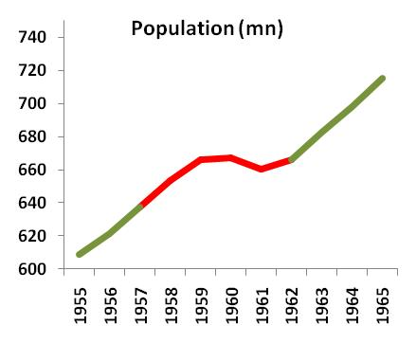
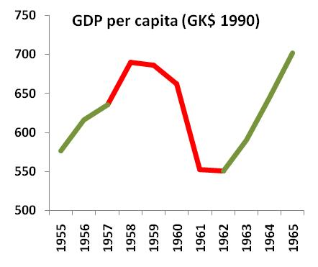
IV. Financial Globalization
Diagram 6: Socialism - political power, fused with the economic power, is unlimited and almost totally crowds out legal markets, e.g.:
Great Leap Forward: China 1958-1962
Growth rates |  |  |  |  |  |  |  | Great Leap Forward
 | 1951 | 1952 | 1953 | 1954 | 1955 | 1956 | 1957 | 1958 | 1959 | 1960 | 1961 | 1962 | 1963 | 1964 | 1965
GDP | 9,6% | 9,5% | 2,7% | 0,9% | 3,5% | 6,9% | 3,2% | 8,6% | -0,6% | -3,5% | -16,5% | -0,4% | 7,2% | 9,2% | 8,8%
Population | 2,0% | 2,1% | 2,2% | 2,4% | 2,2% | 2,1% | 2,6% | 2,5% | 2,0% | 0,2% | -1,0% | 0,8% | 2,5% | 2,3% | 2,4%
Source: Maddison, Statistics on World Population, GDP and Per Capita GDP, 1-2006AD

Slide 25
IV. Financial Globalization
Therefore, the most important safeguard against the deepest crises consists in the division of powers within the society, which includes not only the checks and balances within the state but also private ownership and markets.
It is very superficial to blame the financial crises under capitalism on the markets. Contrary to the textbook presentation, these crises are not a phenomenon which occurs regularly across countries and time. The opposite is true: the incidence of financial crises has been very uneven, which strongly suggests that the differences in countries’ policies are a deeper determinant of financial crisis (see: Selgin, Calomirs). And such policies have been identified: they generally distort the behavior of the financial markets by encouraging excessive lending and borrowing, i.e.. fiscal and private credit booms. These policies include excessively low interest rates (due to interest rate subsidies or low central bank rates), “too big to fail policy”, tax regulations which favor borrowing relative to equity capital, over- generous deposit insurance, etc. Various combinations of these and other policies were also behind the recent global financial crisis (GFC)

Slide 26
IV. Financial Globalization
A financial crisis becomes global when it includes a globally important economy, which nowadays is the US. However, even though the recent GFC is called “global”, its impact has been far from uniform: certain countries were affected much more heavily (e.g. Spain, Ireland, Greece) than others (e.g. Germany, Poland). The popular metaphors “contagion” and “domino effect” are misleading: countries’ vulnerabilities to external financial shocks differ, and this depends again on their institutions and policies.
One can distinguish two types of financial crisis, which have the form of the boom - bust episodes: the financial-fiscal and the fiscal-financial.
In the former case, at the start there is a real estate boom which turns into the bust, causing a recession which spills over to public finance (the deficit explodes). Example include Spain, Ireland, and Britain.
In the case of fiscal-financial crisis at the beginning there is a fiscal boom, which, when burst, spills over to the financial sector, i.e. affects the banks which have financed the government borrowing spree. The best example here is Greece until 2010.

Slide 27
IV. Financial Globalization
Diagram 7: The dynamics of the Financial-Fiscal Crisis:
Inflated tax revenues
The bust
The recession
Wrong policies
Vs.
Inherant instability of the markets?
Private sector boom
The fiscal problems
The financial crisis
 |  | 2001 | 2002 | 2003 | 2004 | 2005 | 2006 | 2007 | 2008 | 2009 | 2010
Household loans to GDP | Ireland | 49,62% | 54,79% | 62,59% | 72,70% | 85,99% | 94,41% | 101,70% | 112,55% | 123,28% | 118,89%
 | Spain | 48,14% | 52,08% | 57,61% | 64,41% | 71,87% | 79,22% | 83,24% | 83,92% | 86,43% | 85,69%
 | United Kingdom | 74,89% | 76,15% | 82,73% | 87,53% | 92,55% | 98,34% | 92,81% | 84,45% | 103,68% | 99,16%
Property price index | Ireland | 60,6 | 64,9 | 74,1 | 82,4 | 88,5 | 100,5 | 100,0 | 90,9 | 78,5 | 66,3
 | Spain | 47,0 | 54,4 | 64,0 | 75,2 | 85,6 | 94,6 | 100,0 | 100,7 | 93,2 | 89,6
 | United Kingdom | 50,3 | 63,0 | 72,8 | 82,9 | 85,6 | 93,5 | 100,0 | 85,3 | 88,1 | 88,6
Source: Eurostat, ECB, Nationwide

Slide 28
IV. Financial Globalization
Even though the deeper causes of the financial crises include various faulty policies, one cannot deny, that the risks of various disturbances in a financially interconnected world are higher than in a world where countries are financially isolated from each other. However, these risks have to be compared with the huge gains due to financial globalization if the right institutions and policies are in place.
Institutions in the host countries determine not only the amount of the incoming financial flows (Policy 1 in diagram 1) but also their composition (Policy 2).
As I noted in section I, FDI is from the point of view of economic growth the most important financial inflow because of its strong link to technology transfer. However only some countries get large amounts of FDI: those with institutions and policies which respect private property rights and create a reasonable expectation that sudden policy reversals will be avoided. Very large economies like China can attract for a certain time, large amounts of FDI even if these fundamentals are weak.
Some other financial inflows, e.g. portfolio capital, international bank lending, are less strongly linked to the host country’s economic growth. This is especially true if these inflows finance mortgage credit booms, or fiscal booms. However, one should remember that these excesses are largely due to various combinations of bad policies rather than the inflows themselves.

Slide 29
IV. Financial Globalization
Diagram 8: The dynamics of Fiscal- Financial Crisis
The destructive political competition
Weak constraint on the government
The systematic overspanding (welfare spending, government consumption)
The fiscal problems
Problems in financial sector
sometimes
sometimes
Slow growth due to the worsening institutional system
Falling employment and/or increasing structural unemployment
Antimarket or anticompetitive regulations
Growing public sector
Windful gains
Discovery of gas etc. (the Netherlands in the 1970s)
Lowering of the interest rates (Greece, Portugal, Spain, Italy)
 |  | 1990 | 1995 | 2000 | 2005 | 2006 | 2007 | 2008 | 2009 | 2010
Greece | General government total expenditure | 43,43 | 43,17 | 46,64 | 43,95 | 45,16 | 46,64 | 49,65 | 52,84 | 49,48
 | General government net lending/borrowing | -14,51 | -6,99 | -3,69 | -5,30 | -6,12 | -6,69 | -9,80 | -15,51 | -10,42
 | General government net debt | 64,22 | 66,40 | 77,41 | 100,29 | 106,11 | 105,41 | 110,72 | 127,10 | 142,76
Portugal | General government total expenditure | 39,26 | 39,66 | 39,29 | 42,42 | 40,82 | 44,30 | 44,64 | 49,83 | 50,64
 | General government net lending/borrowing | -5,06 | -3,41 | -1,09 | -2,54 | -0,36 | -3,15 | -3,54 | -10,11 | -9,14
 | General government net debt | n/a | n/a | 41,97 | 57,95 | 58,77 | 63,66 | 67,36 | 78,79 | 88,70
Source: IMF

Slide 30
V. Concluding Comments
The globalization process depends on the policies in the respective countries, especially the large ones, and on other factors, especially on the technical change. One should focus on a policies so that are no reversals in the degree of countries external opening and that their institutions allow for a better individuals’ adjustment to new opportunities or threats. The globalization process may slow down if the technical change changes the distribution of profitable locations of economic activity in the world, or because of the inevitable slowdown in China.(Bordo, Eichengreen...)
In discussing the outcomes ascribed to globalization one should distinguish the symptoms from the causes. Globalization is to often blamed for the results of bad policies, especially those which hamper individuals’ adjustment to new pressures, and those which encourage them to take excessive risks.

Slide 31
V. Concluding Comments
Crude globalization, based on the nationalistic or utopian ethics is, indeed, very demagogic. However, it should not be neglected because the emotional irrationality appeals to many people, and therefore, can, have dangerous political consequences
In defending the achieved level of globalization one should appeal to its beneficiaries who would become losers, if policies turn to trade protectionism. This is especially relevant for the US.
The European Union can and should play the role of the center in defending the free trade in the world. At the same time it should resist the protectionist pressures within its own Single Market.

Slide 32
Thank you for your attention!
Let us stay in touch:
twitter.com/LBalcerowicz
for.org.pl
facebook.com/LeszekBalcerowicz
30yearsoffreedom.for.org.pl/

